Slide 1
Thesis in DATA SCIENCE – D7059E Stylometry: Quantifying Classic Literature for Authorship Attribution
A Machine Learning Approach
By Jacob Yousif and Donato Scarano
Date: 2024-06-05

Slide 2
Agenda
LAYOUT GUIDE
Use this slide if you would like to include an agenda in your presentation.
The times and agenda items are placed in an invisible table to align the text.
You can write times (as shown), numbers (1,2,3…) or letters (A,B,C…) in the left column, or delete them altogether
Click on the table and go to the
Layout tab to add or delete rows.
--------------
This info box will not appear when you present your slide.
10:00 | Introduction (5 minutes)
10:05 | Method (10 minutes)
10:15 | Results (10 minutes)
10:25 | Summary (5 minutes)
10:30 | Opposition (15 minutes)
10:45 | Q & A (10 minutes)

Slide 3
Acknowledgment
LAYOUT GUIDE
Use this slide if you would like to include an agenda in your presentation.
The times and agenda items are placed in an invisible table to align the text.
You can write times (as shown), numbers (1,2,3…) or letters (A,B,C…) in the left column, or delete them altogether
Click on the table and go to the
Layout tab to add or delete rows.
--------------
This info box will not appear when you present your slide.
Grammarly: Text Refinement
Google Scholar: Literature review and references
ChatGPT: LaTeX layout

Slide 4
INTRODUCTION Motivation: Analyze the classic literature to uncover insights and using advanced machine learning models such as RoBERTa and others for authorship attribution.
MONETIZATION
Fake news detection
Writing style consistency to match client preferences
Plagiarism, copyright infringement and fraud cases
DIGITALIZATION
Revolutionize how information is handled
Promote the conservation of literary heritage
NOVEL PERSPECTIVES
Lexical Structure Studies
Literature Criticism
Cultural Insights
CONTRIBUTION
Stylometry analysis
Modern and advanced models
Authorship classification
DELIMITATION
16 authors with 3 books per author
Defined research questions to address
ETHICS
Intellectual property
Data Privacy
Transparency
Fair Usage
Inclusivity

Slide 5
RESEARCH QUESTIONS
RQ1: What role do textual features play in the readability and complexity of classic literary texts?
RQ2: How effective is segmenting and quantifying texts into a numeric tabular dataset and using it with predictive models to predict the authorship of text segments in multiclass classification tasks?
RQ3: To what extent can RoBERTa effectively identify the author of text segments across multiple authors?
RQ4: How does the size of the training dataset impact RoBERTa’s performance in multiclass classification?

Slide 6
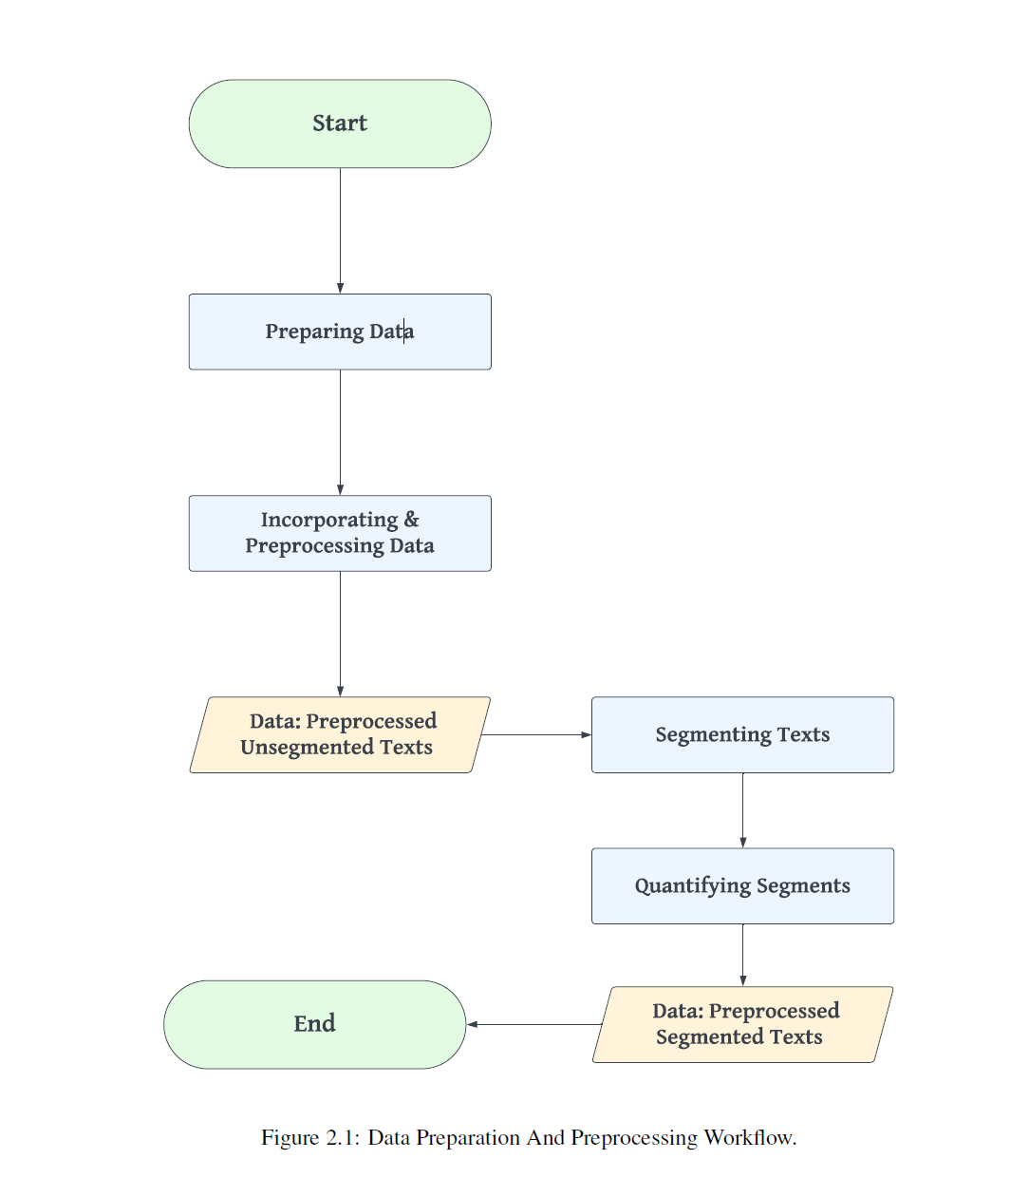
METHOD
PROCESS STAGES:
DATA PREPARATION AND PREPROCESSING
DATA ANALYSIS
LITERATURE ANALYSIS
AUTHORSHIP CLASSIFICATION
LIGHTGBM
TABNET
RoBERTa
VALIDATION

Slide 7
RESULTS
RQ1
RQ2
RQ3
RQ4
Optimal number of clusters k = 3
Results of the stylometry analysis indicate that textual features can be used to distinguish writing styles
Not all features maintain high correlations some feature engineering may be needed to exclude irrelevant features.
LightGBM:
70% Training, 15% Validation, 15% Testing
16 authors 53% accuracy
4 authors 78% accuracy
TABNET:
70% Training, 15% Validation, 15% Testing
16 authors 50% accuracy
4 authors 74% accuracy
Improvements needed to optimize performance; dataset imbalance could impact performance.
RoBERTa
16 authors 96% accuracy
4 authors 97% accuracy
Balanced performance on the scores of Precision, F1-score and Recall as well.
RoBERTa has shown robust performance in both classification tasks.
The dataset imbalance has not affected its performance.
It has achieved high performance in the authorship attribution being a pretrained model.

Slide 8
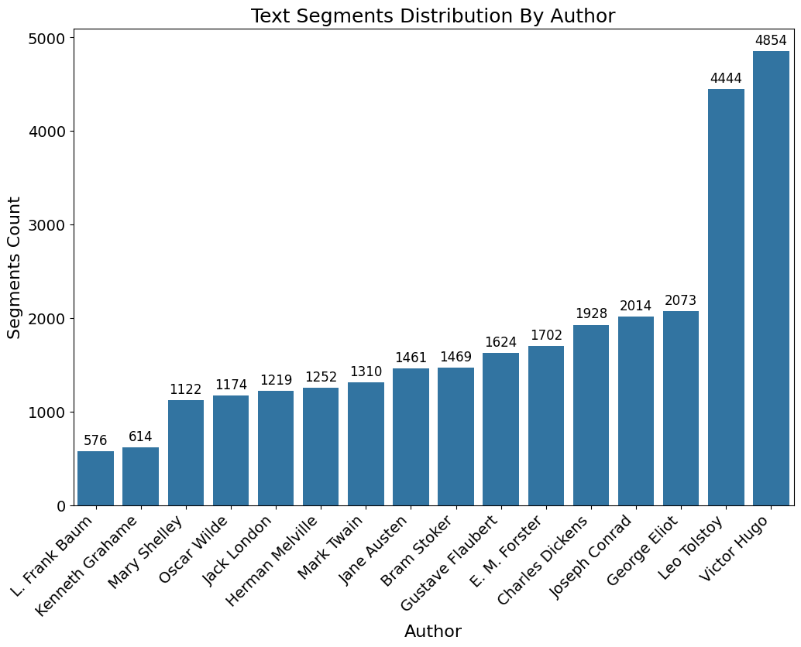
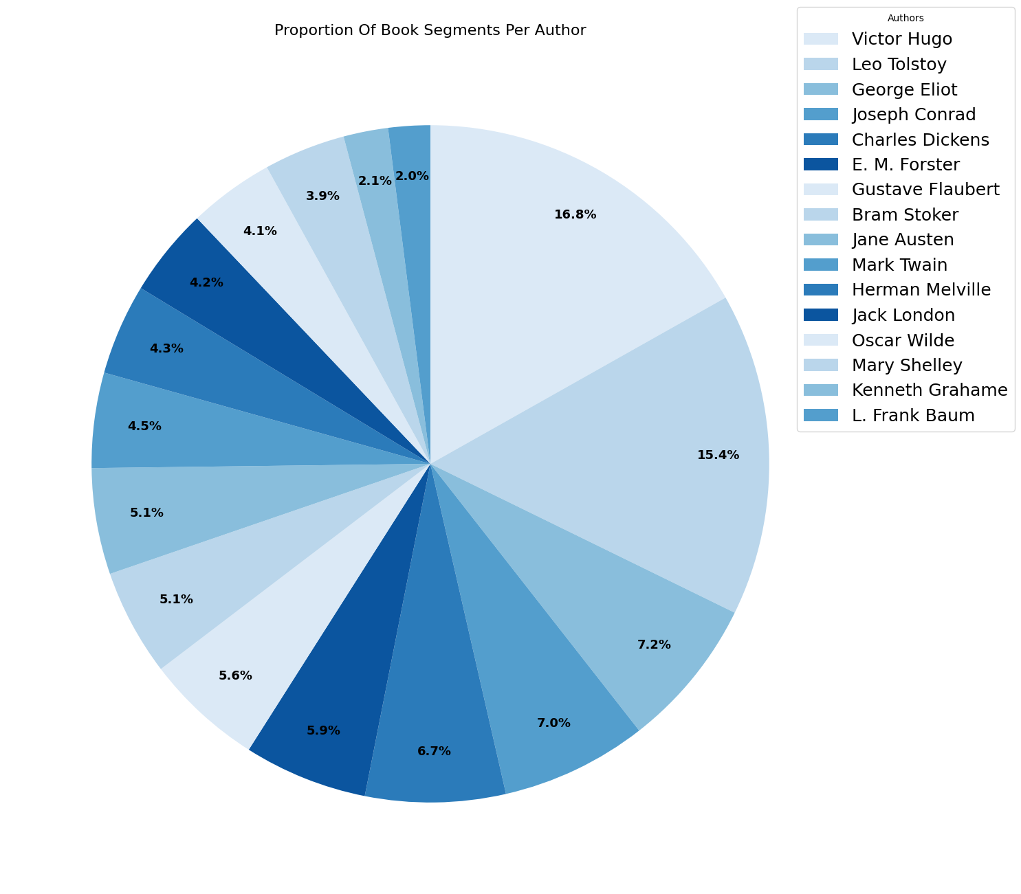
RESULTS
Preprocessed Data: 8,922,516 tokens, and 28,836 text segments.

Slide 9
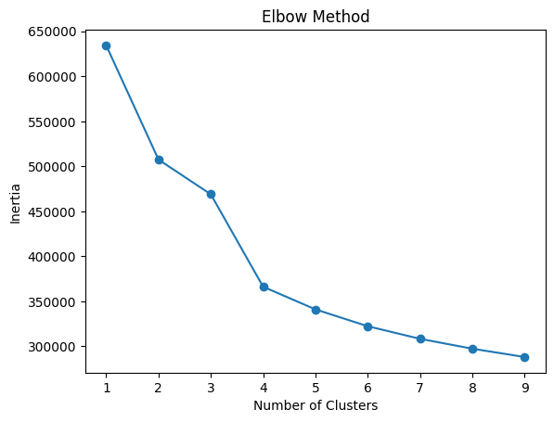
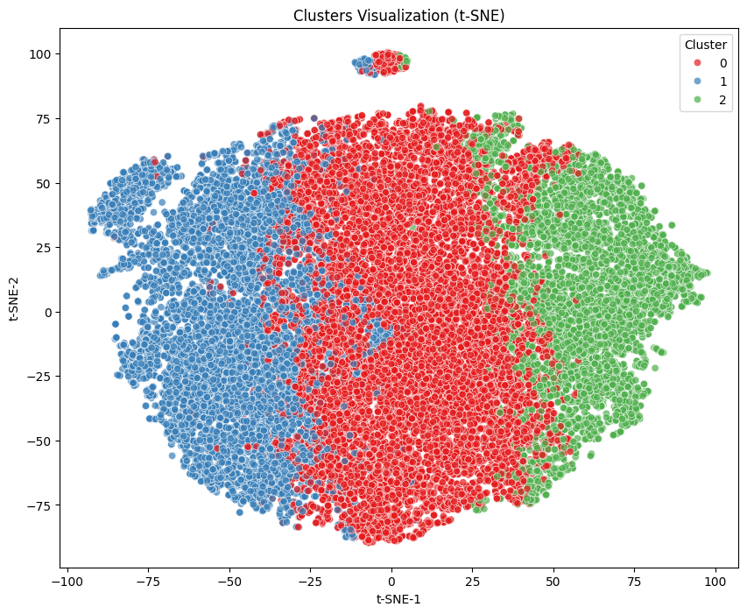
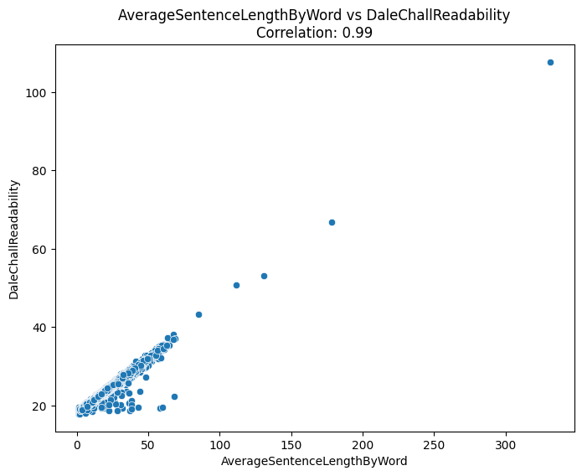
RESULTS
RQ1

Slide 10
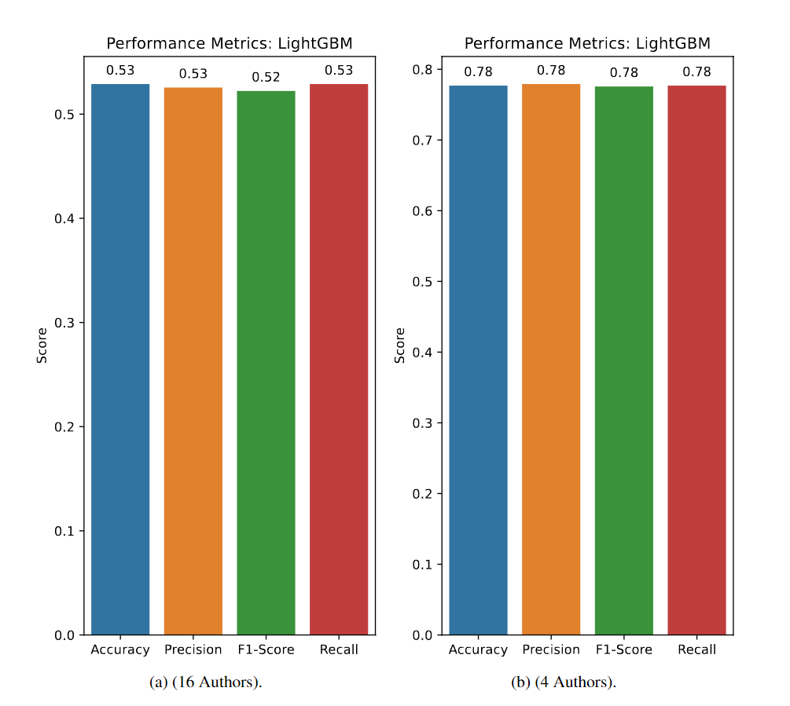
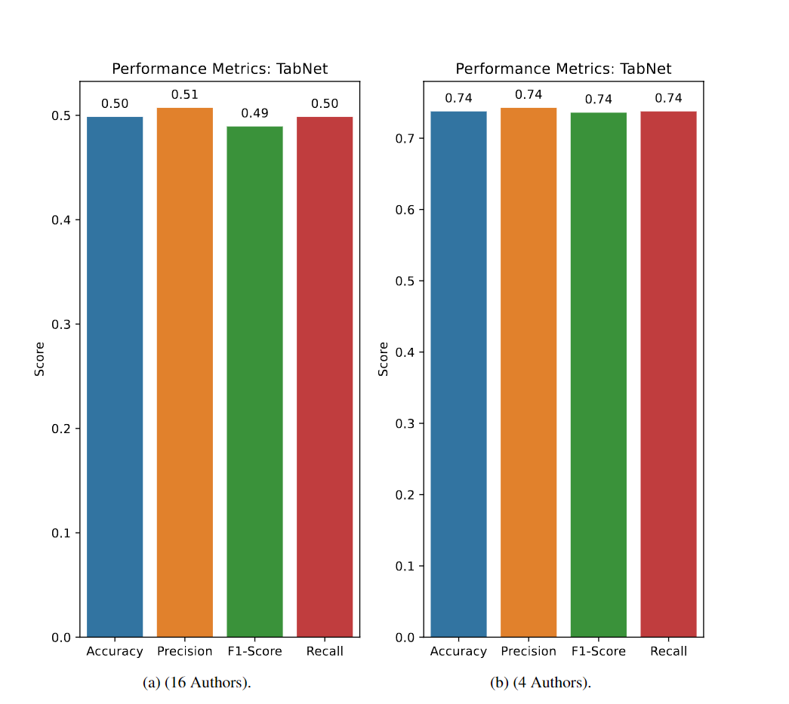
RESULTS
RQ2

Slide 11
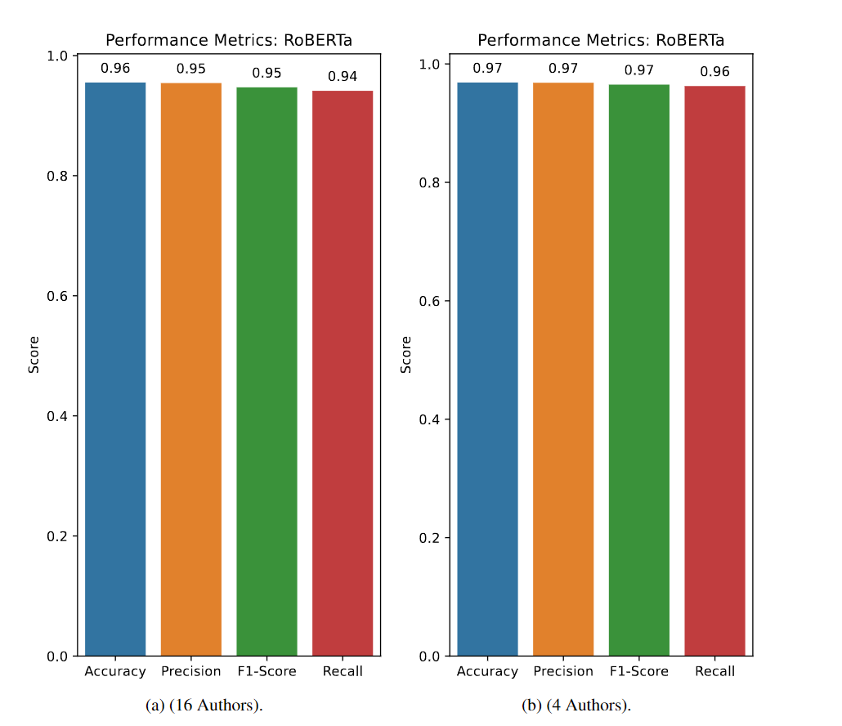
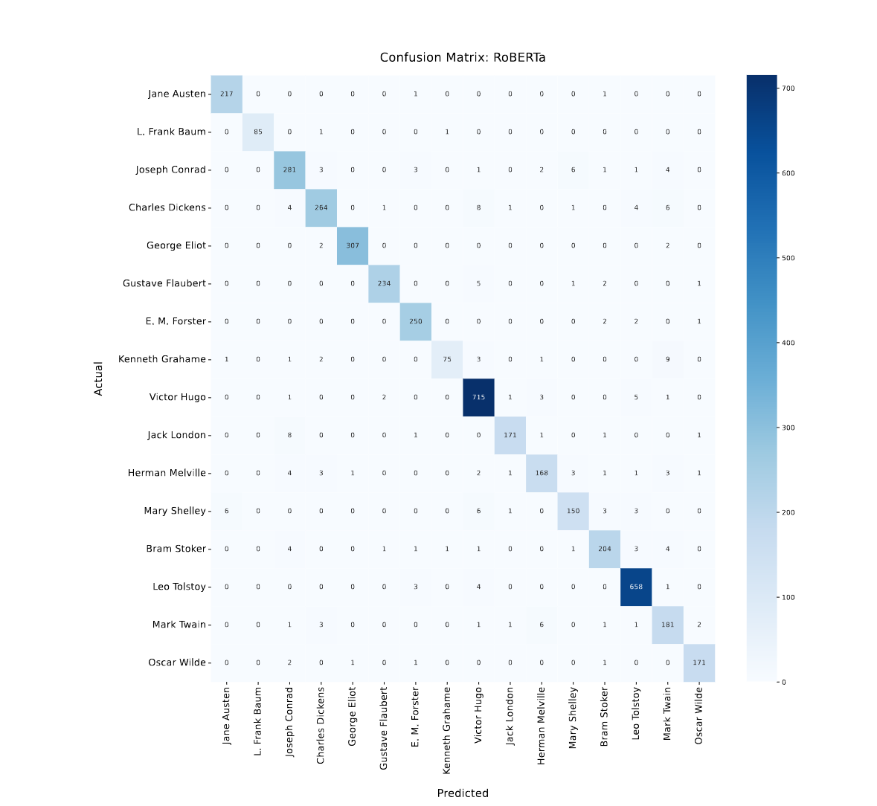
RESULTS
RQ3 & RQ4

Slide 12
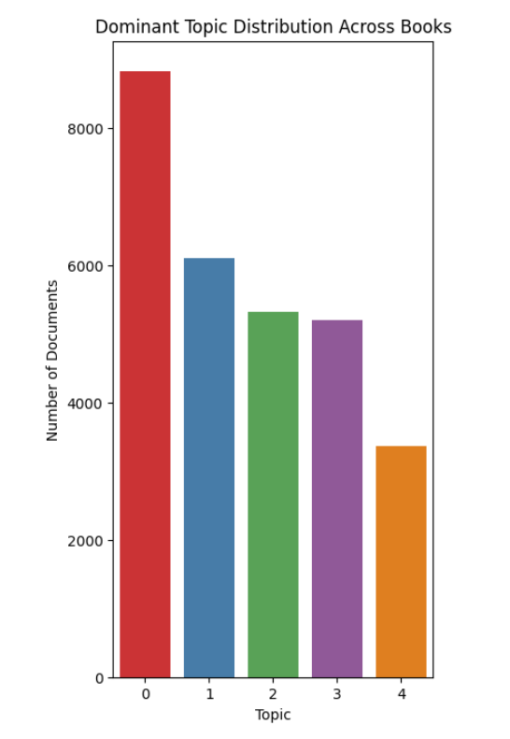
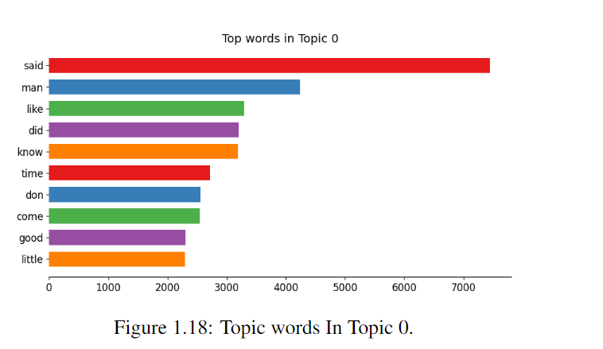
RESULTS
Side Contribution: Exploratory Analysis

Slide 13
Summary
Our study demonstrated the feasibility of segmenting text and quantifying it using stylometry analysis either for analyzing text or conducting authorship attribution.
The study uncovered the books’ characteristics very well and offered insights on linguistic features
The biggest hurdle was the limitation of computing power and memory which slowed our progress and did not allow us to extend the dataset to a larger number of books.
We have compared and benchmarked our study with many related works a complete list of the works, its description and comparison is available in the final report.

Slide 14
Future work
Further work is planning to use stylometry metrics to focus on a smaller set with different and unique linguistic features and enhance the number of books per author.
Adjust the segment size to different lengths to determine the optimal size with more significant information gain and better performance
Evaluate different texts from different eras to understand the evolution of writing styles and linguistic features.

Slide 15
15
Jacob Yousif e-mail: jacyou-0@student.ltu.se
Donato Scarano e-mail: donsca-3@student.ltu.se

Slide 16
Luleå University of Technology Logotype

